Slide 1
Predicting Collision Severity
A machine learning-based approach

Slide 2
Why predict collision severity?
Traffic accidents vary in size and severity and require different approaches
Emergency services are often unable to assess which resources are needed to alleviate calamities
Predictive modelling could help to:
Improve resource allocation
Estimate nuisance caused by accidents
Road users are interested as well
Safety
Better emergency aid

Slide 3
Data acquisition and cleaning
Collision data from the city of Seattle, provided as example data as part of the IBM Applied Data Science Capstone
In total, 188,409 rows over 37 features
Dropped time-based data, duplicate features and aggregated locational data into high risk locations
Cleaned data contains 8 features

Slide 4
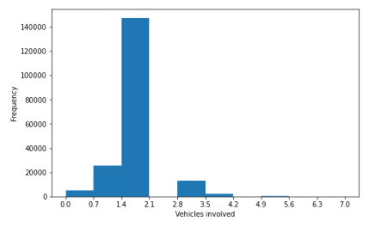
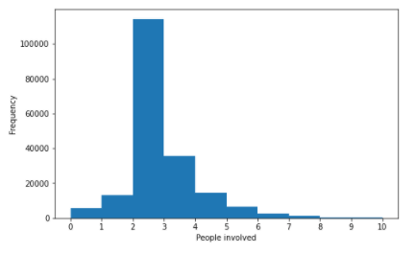
Data set is highly skewed
Vehicles involved
Number of people involved

Slide 5
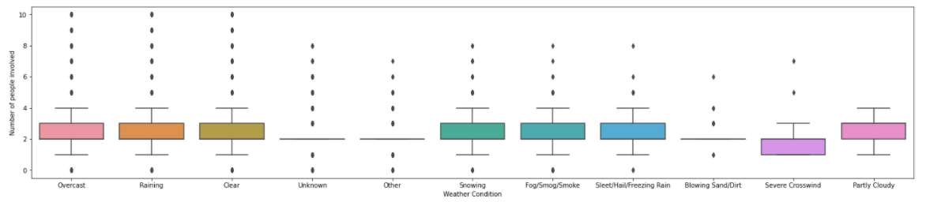
Number of people involved is insensitive to weather conditions

Slide 6
Solutions for data skewness
Removed outliers from number of people and vehicles involved
Insensitivity explained by:
Data skewness eliminating variance -> data is biased towards small accidents
Person and vehicle count are not appropriate as proxies for collision severity
Therefore, actual target variable: severity code
1 for property damage, 2 for injury

Slide 7
Classification model
Target variable is binary, therefore classification is most appropriate as modelling technique
Due to large dataset (188,617 rows), only the following algorithms:
Logistic regression
Decision tree
K-nearest neighbour (slower, yet viable)
SVM excluded due to computational inefficiency

Slide 8
Results
Decision tree performs best amongst algorithms, although K-nearest neighbor is similar in performance
Log loss for logistic regression displays large prediction error -> insufficiently accurate
Algorithm | Jaccard | F1-score | LogLoss
KNN | 0.71 | 0.69 | NA
Decision Tree | 0.72 | 0.70 | NA
Logistic Regression | 0.69 | 0.65 | 0.57

Slide 9
Discussion
Model is biased towards small accidents
Not directly an issue, corresponds to real-world behavior
Model will perform worse at predicting severity of large-size accidents
Target variable only reflects whether a certain level of severity was achieved
Omits size of property damage or number of casualties
Lacks substance to fully assess gravity of accident
General model, not tailored for specific conditions. For example:
Extreme environmental conditions (ice on the road and snowy weather)
Predicting the severity of large scale accidents only

Slide 10
Recommendations
Collect data to transform severity code to score
Use numerical score, representing absolute accident size
Focus on WHAT the accident entails, rather than WHERE it happened
Locational data did not affect model performance

Slide 11
Conclusion & Recommendations
Built useful, general-purpose model to predict collision severity
Model constraints leave room for improvement
Future research should be directed towards:
Enriching the data set with (numerical) data on property damage and the number of casualties
Transforming the severity code to a severity score, incorporating accident size

